Slide 1
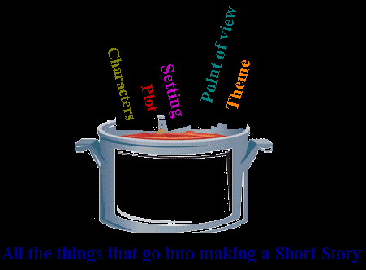
Short Stories
Types of Conflict & Elements of a Short Story!

Slide 2
The 5 types of Conflict:
Person vs. Person
Person vs. Society
Person vs. Nature
Person vs. Themself
Person vs. Technology

Slide 3
Person vs. Person
Problem with Another Character!

Slide 4
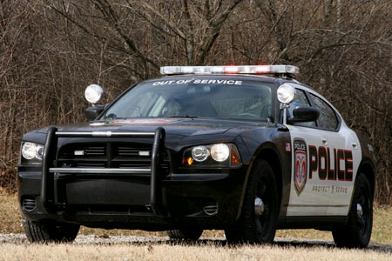
Person vs. Society
Problem with the laws or the beliefs of a group.

Slide 5
Person vs. Nature
Usually involves a problem with a natural force like a flood or a storm, or even wild animals.

Slide 6
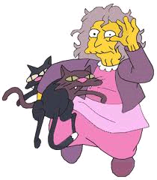
Person vs. Themself
Problems deciding what to do or think, character could become mad like Hamlet in the Shakespeare play.

Slide 7
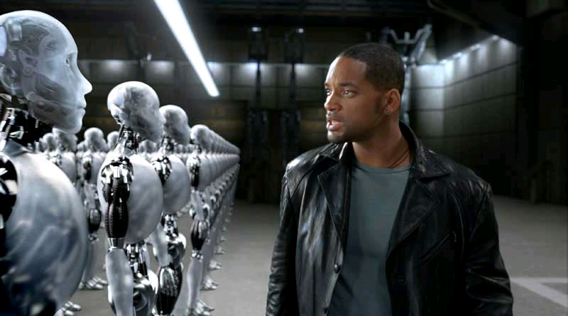
Person vs. Technology
Common theme in science fiction type stories, it is a struggle with technological forces.

Slide 8
Plot (story) Line

Slide 9
Plot Structure

Slide 10
Plot Structure
The Initial Incident is the incident which begins the central conflict in the story.

Slide 11
Plot Structure

Slide 12
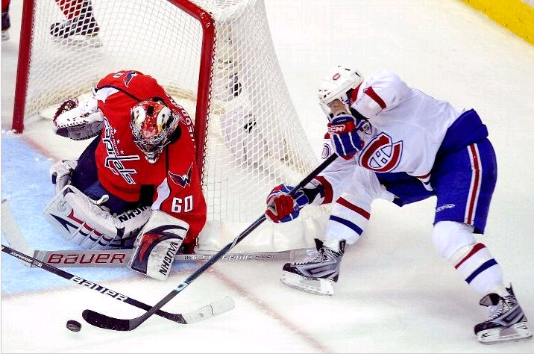
Plot Structure
Turning Point is an indication that the climax is about to occur; a decisive moment at which a crucial decision must be made.

Slide 13
Plot Structure

Slide 14
Plot Structure

Slide 15
Plot Structure

Slide 16
Characterization
Characterization is the author’s description and explanation of the people in the story
Their thoughts
Appearance
Actions
What they say
What others think about them
Comparisons with other characters

Slide 17
Types of Characters
Main Characters: are characters who are central to the conflict.
Protagonist: is the chief character of a story, on whom our interest centers.
Antagonist: is the character or force pitted against the protagonist; can be one or many.
Flat Characters: are built around a single idea or quality. The can be described in a simple phrase or sentence.
Foil: is a character opposite in personality to that of the main character, the foil contrasts severely with the main character; together they illuminate each other’s strengths and weaknesses.
Round Characters: are complex in temperament and motivation and they are as difficult to describe as real people. Capable of surprising us as readers.

Slide 18
Points of View
Omniscient (All Knowing)
Author tells the story (3rd person)
Author reveals the thoughts and feelings of more than one character.
Advantage: flexibility (author can interpret)
Disadvantage: may destroy the sense of reality.

Slide 19
Points of View
First Person
Character tells the story.
Character reveals his/her thoughts and feelings in the story
Advantage: intimacy- perhaps you identify with the character
Disadvantage: no author to interpret directly

Slide 20
Points of View
Limited (sometimes called Limited Omniscient)
Author tells the story (3rd person)
Author reveals the thoughts and feelings of one character
Advantage: more realistic, you usually consider a single point of view.
Disadvantage: less flexible, less room for interpretation

Slide 21
Points of View
Objective
Author tells the story (3rd person)
Author does not reveal thought and feelings of any character
Advantage: speed of action – the story moves quickly, good for a surprise ending
Disadvantage: no interpretation possible by author

